Slide 1
Group 5 project4 Metro ticket machine
Students:
Mohamed Ahmed 79573
Omar Ashraf 80601
Assem Yasser 80681
Khaled Abdel Nasser 80768
Ahmed Ayman 80836

Slide 2
Abstract:
In this presentation we will explain the automation of metro ticketing system by using the RFID reader and cards so we can identify the card is valid or invalid
indicating it using green led and buzzer for valid cards and red led for invalid cards
servo motor to simulate the entrance of the person through the gate
lcd to indicate the purpose of the gate whether entrance or exit
we use seven segment module to indicate the number of the people in the station that is going to increase when someone go in and decrease when someone go out of the station
we used the SPI communication protocol in the communication between the Arduino mega2560 which is the controller of the system and the RFID reader
Arduino IDE to write the code for the system and upload it to the Arduino from the computer .and we protues to draw the circuit of the system .

Slide 3
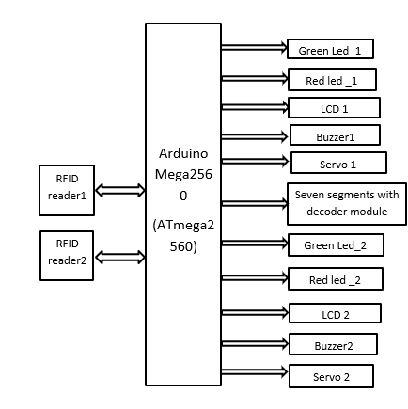
Block diagram for the project:

Slide 4
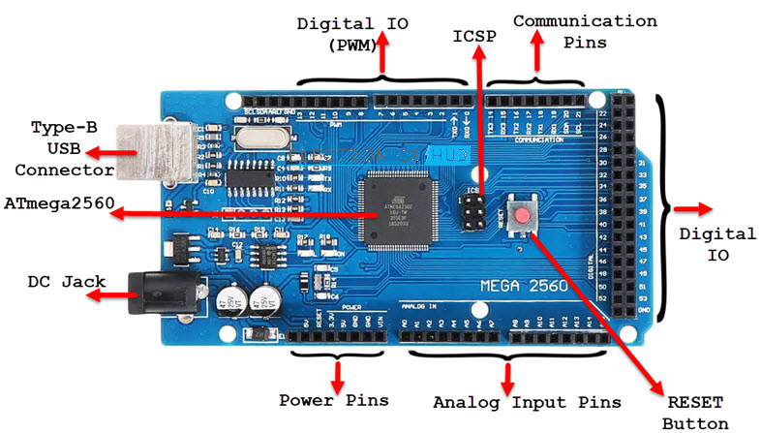
The components of the system:
1-Arduino mega 2560:
The controller of the system. Arduino Mega is based on ATmega2560 Microcontroller, an 8-bit AVR Architecture based MCU from ATMEL.
MCU | ATmega2560
Architecture | AVR
Operating Voltage | 5V
Input Voltage | 6V – 20V (limit) 7V – 12V (recommended)
Clock Speed | 16 MHz
Flash Memory | 256 KB (8 KB of this used by bootloader)
SRAM | 8 KB
EEPROM | 4 KB
Digital IO Pins | 54 (of which 15 can produce PWM)
Analog Input Pins | 16

Slide 5
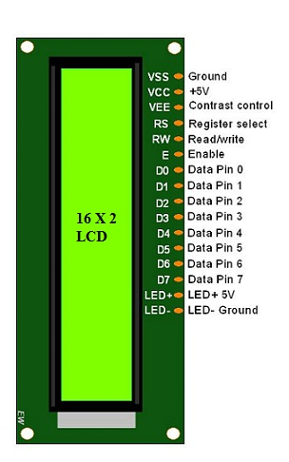
2-LCD:
The term LCD stands for liquid crystal display.
The features of this LCD mainly include the following.:
The operating voltage of this LCD is 4.7V-5.3V
It includes two rows where each row can produce 16 characters.
The utilization of current is 1mA with no backlight
Every character can be built with a 5×8-pixel box
The alphanumeric LCDs alphabets & numbers
Is display can work on two modes like 4-bit & 8-bit

Slide 6
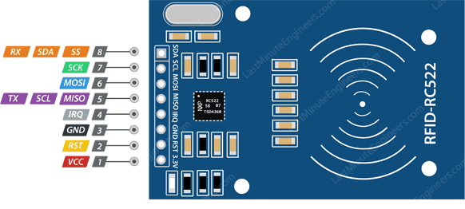
3-RFID(RC522):
An RFID or radio frequency identification system consists of two main components, a tag attached to the object to be identified, and a reader that reads the tag.
Frequency Range | 13.56 MHz ISM Band
Host Interface | SPI / I2C / UART
Operating Supply Voltage | 2.5 V to 3.3 V
Max. Operating Current | 13-26mA
Min. Current(Power down) | 10µA
Logic Inputs | 5V Tolerant
Read Range | 5 cm

Slide 7
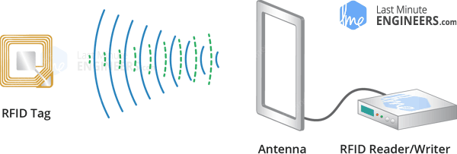
Working principle of the RFID:
A reader consists of a radio frequency module and an antenna that generates a high frequency electromagnetic field.
Whereas the tag is usually a passive device (it does not have a battery).
It consists of a microchip that stores and processes information, and an antenna for receiving and transmitting a signal.

Slide 8
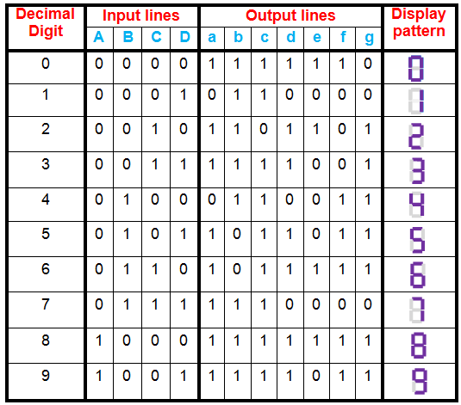
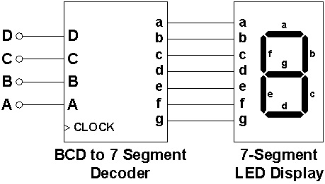
4-BCD to Seven Segment Decoder:
BCD to seven segment decoder is a circuit used to convert the input BCD into a form suitable for the display. It has four input lines (A, B, C and D) and 7 output lines (a, b, c, d, e, f and g) as shown in Figure 3. Considering common cathode type of arrangement, be given as in Table

Slide 9
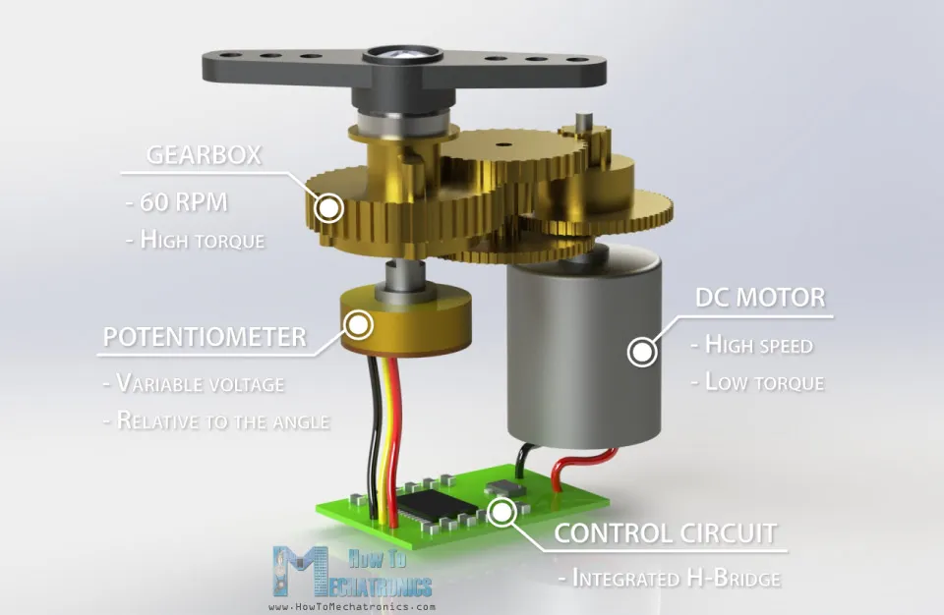
5-servo motor:
A servo motor is a closed-loop system that uses position feedback to control its motion and final position. hobby servos the position sensor is usually a simple potentiometer. The actual position captured by these devices is fed back to the error detector where it is compared to the target position.
Stall Torque | 1.2kg·cm @4.8V, 1.6kg·cm @6V,
Operating Voltage | 3.5 – 6V
No Load Current | 100mA
Stall Current | 650mA
Max Speed | 60 degrees in 0.12s
Weight | 9g

Slide 10
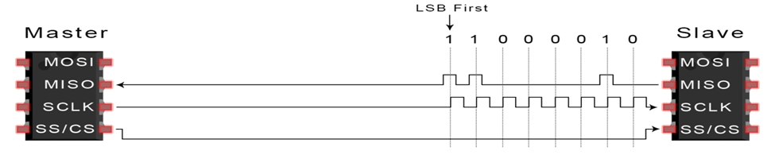
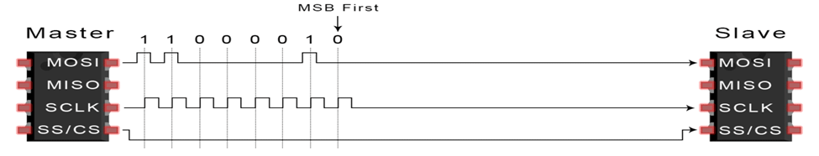
SPI Communication:
SPI is a common communication protocol used by many different devices. For example, SD card reader modules, RFID card reader modules, and 2.4 GHz wireless transmitter/receivers all use SPI to communicate with microcontrollers.
One unique benefit of SPI is the fact that data can be transferred without interruption.

Slide 11
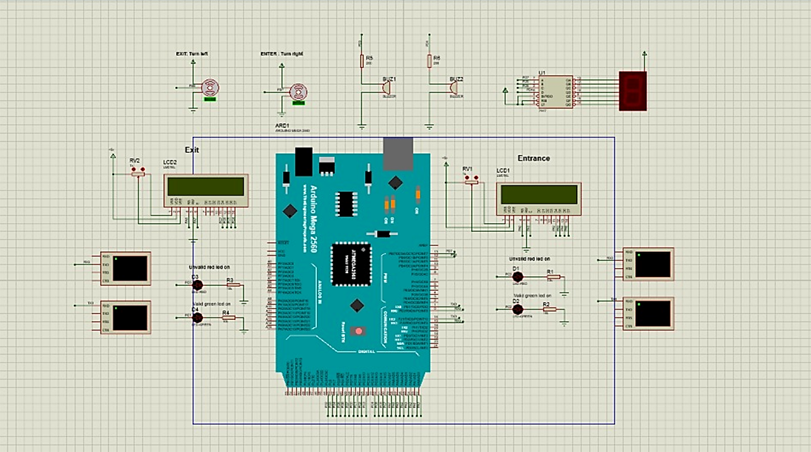
Circuit of the system :
Buzzer_1 → pin 2
green_Led_1→ pin 31
red_Led_1 → pin 30
buzzer2 → pin 42
green_Led_2 → pin 44
red_Led_2 → pin 39
lcd→pins (22,23,24,25,26,27)
lcd2→pins (32,33,34,35,36,37)
rf1 →pins (5,28,51,50,53)
rf2→pins (6,38,51,50,53)
servo_1 → pin (8)
servo_2 → pin(11)
seven segments →pins(16,17,18,19,20,21)

